Slide 1
DAT Class 15
Machine Learning With Python

Slide 2
Regularization
Machine Learning With Python

Slide 3
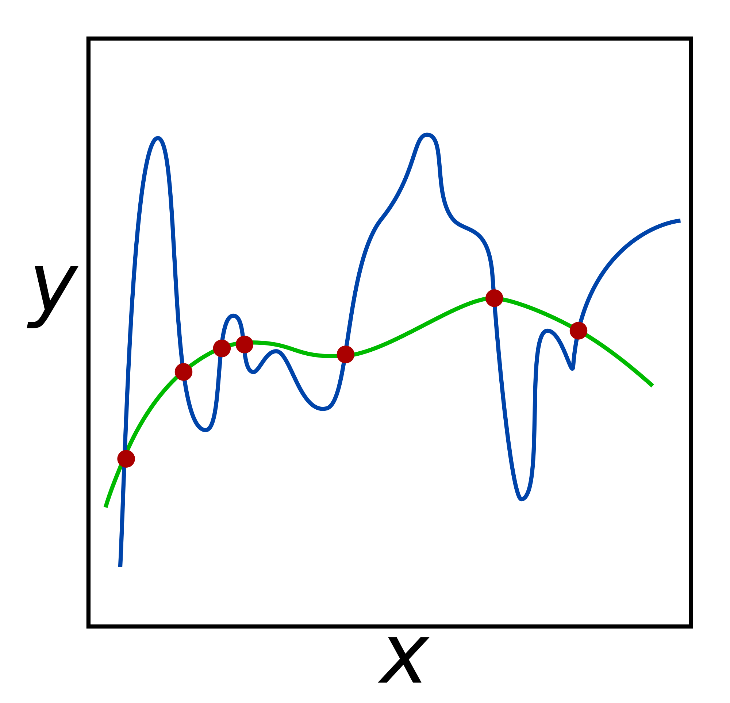
Regularization
Commonly used technique to curb overfitting in your models.
Does so by deliberately injecting a measured amount of bias into your model
You call bias injection a ‘penalty’
Result is that it shrinks your weights
Also known as ‘weight’ decay
Used in most algorithms that use gradient descent for optimization
Notes:
This is where you go and introduce the training and test split. Go through the shapes of the returned values, make sure everyone is clear on what’s happening.
For

Slide 4
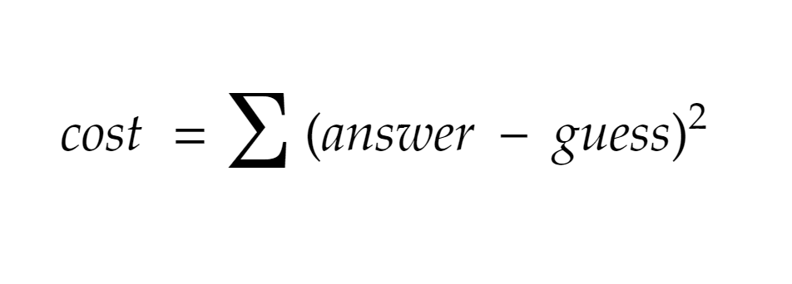

Slide 5
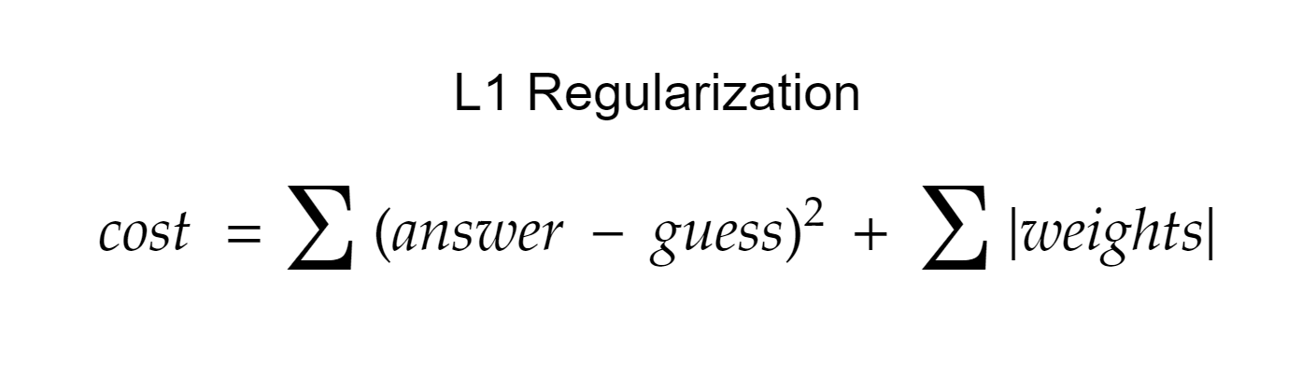

Slide 6
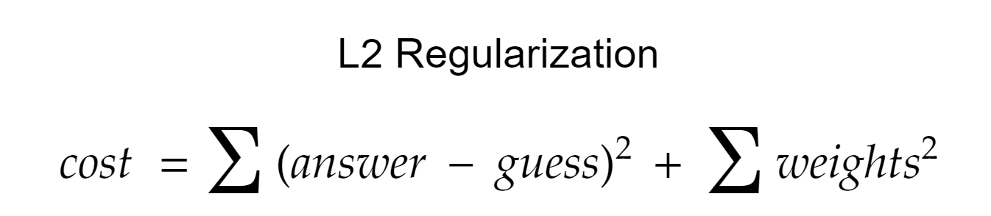

Slide 7
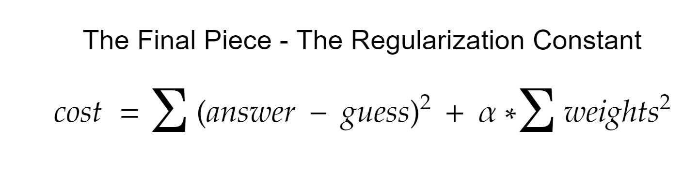
Notes:
Go into your next segment here, and

Slide 8
Regularization
The regularization parameter:
Has different names:
Alpha
Lambda
C
Determines the strength of your regularization
Common parameter to test in cross validation

Slide 9
Regularization
Regression with an L2 penalty is called Ridge Regression
Regression with an L1 penalty is called Lasso Regression
Regularization is used on a lot of ML algorithms - basic concepts are the same throughout
Always a good idea to regularize - to not do it is usually a mistake

Slide 10
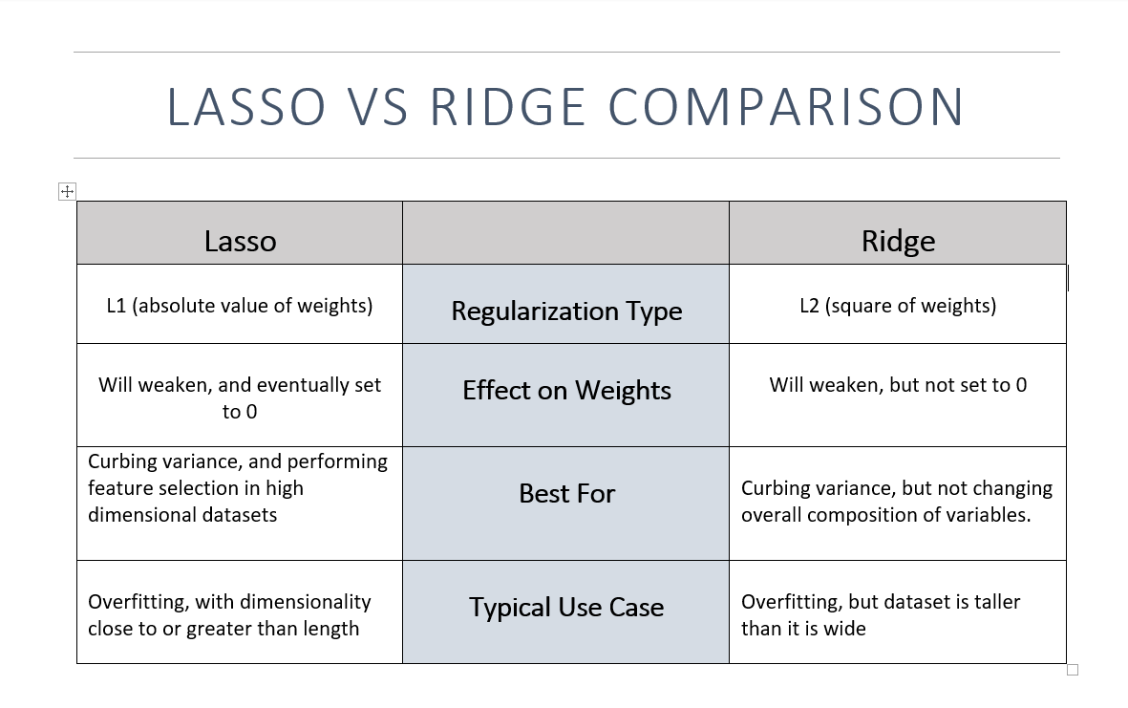
Notes:
After this slide, introduce Ridge Regression, point out alpha as a parameter, and make the chart -- decide for yourself if it’s a good idea to do it by hand or not.

